Slide 1
LARC Zimbabwe Goals & Indicators

Slide 2
Overarching Goals:
“Make Every Test (Viral Load) Count”
Clinical → Phased Approach:
Phase 1. Improve Documentation of Viral Load Test Results
Phase 2. Improve Patient Care According to Guidelines
Phase 3. Improve Viral Load Coverage
Laboratory
Improve turnaround time (TAT), time from sample collection to time results reach clinic
Improve Specimen Rejection Rates
Improve Communication of “Invalid” Results

Slide 3

Overarching Goal Phase 1:
Improve Documentation of Viral Load Test Results
Aim #1 – Increase proportion of Viral Load Test Results recorded in patient record (Green Book) from _________ to 95% by 22 January 2020.

Slide 4
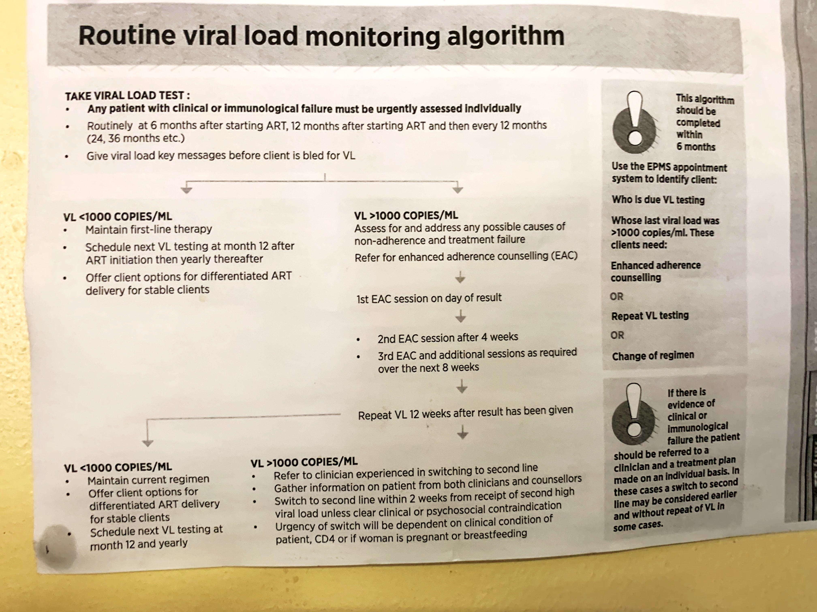
Overarching Goal Phase 2:
Improve Patient Care According to Guidelines
Aim #2 – Outcome
Increase proportion of High Viral Load Patients cared for according to guidelines* from _________ to __________ by 15 November 2020.
* 3 EACs & Repeat VL Test in 4 months

Slide 5
Overarching Goal Phase 2:
Improve Patient Care According to Guidelines by decreasing Missed Appointments
Aim #2 – Process
Decrease proportion of High Viral Load Patients with missed appointments* from _________ to __________ by 15
November 2020.
* EAC #1, #2, & #3 and VL Repeat Appointments

Slide 6
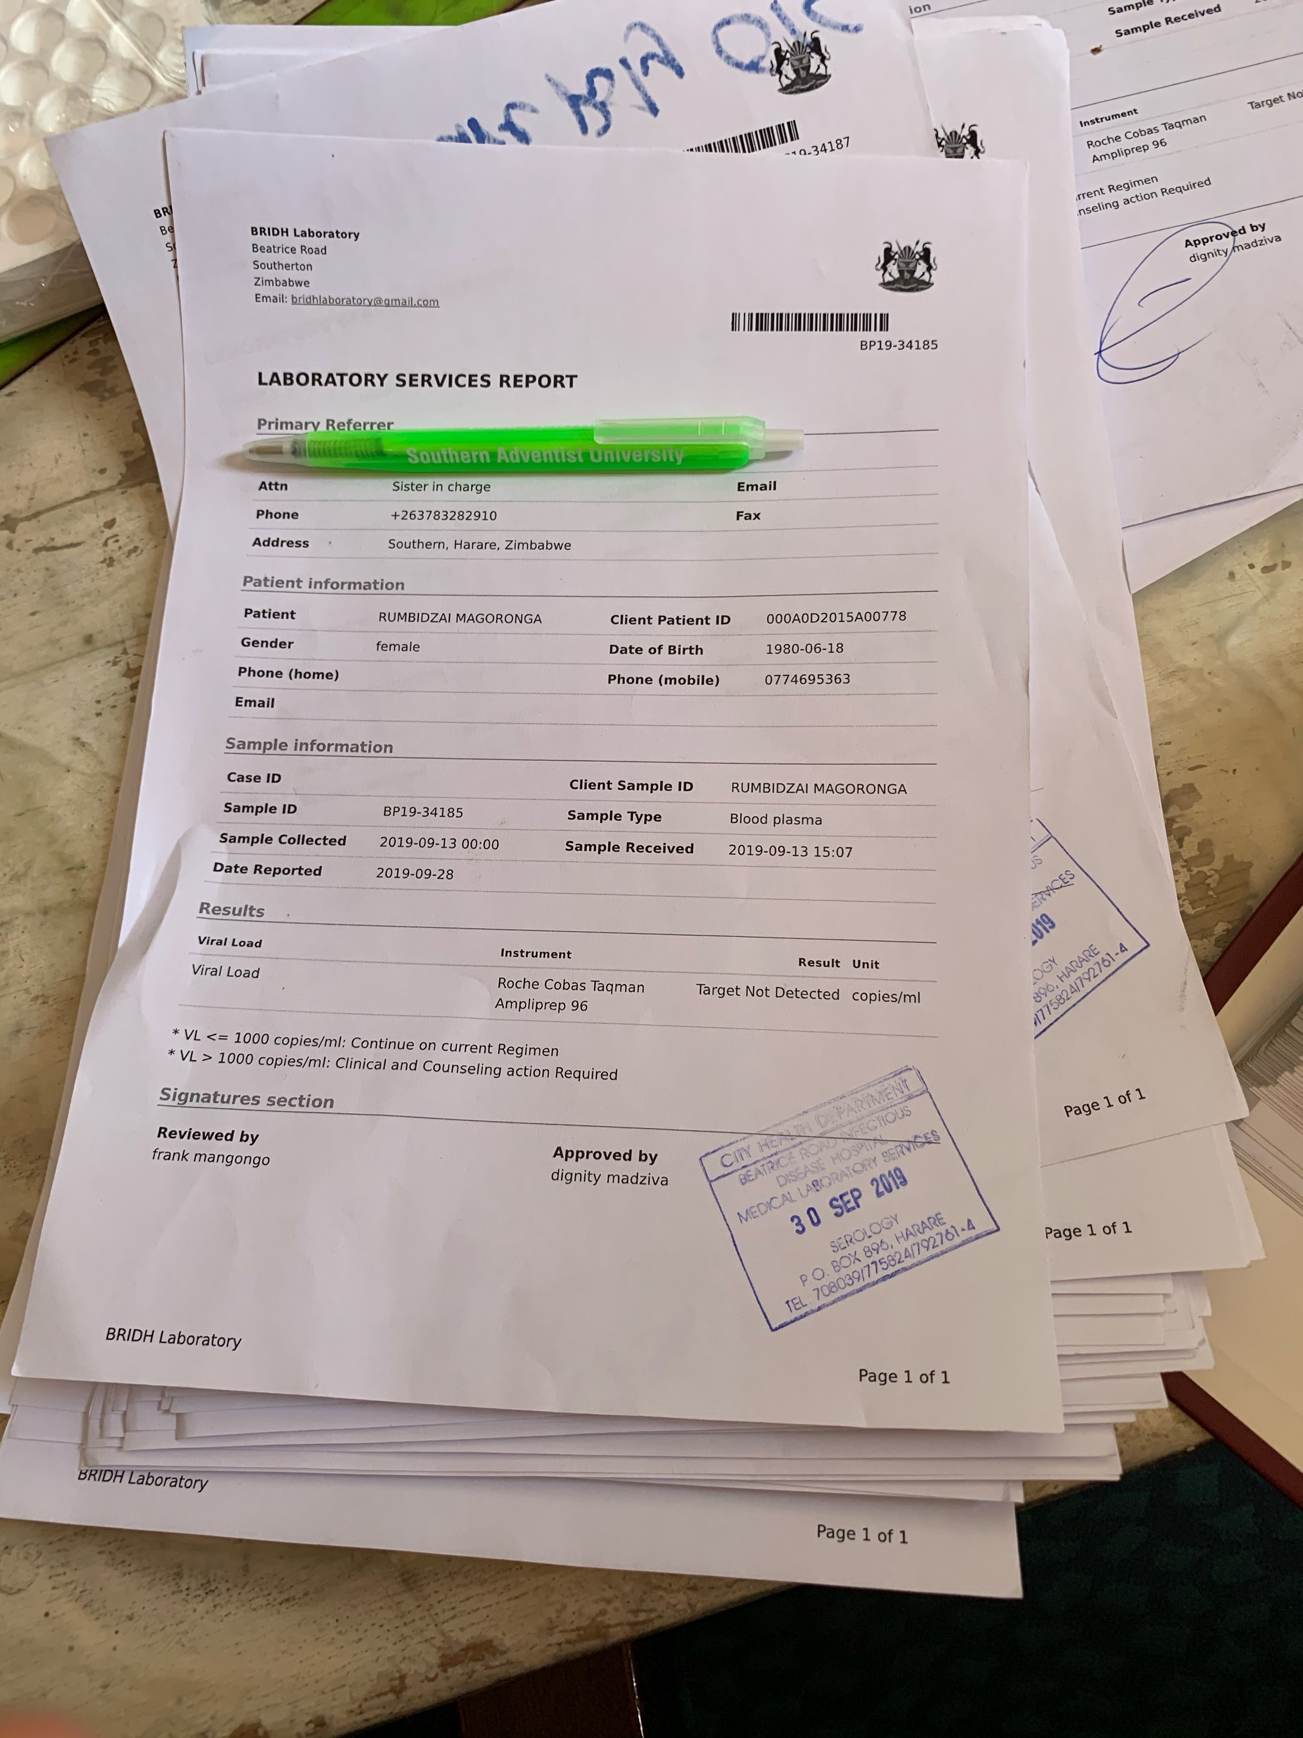
Overarching Goal Phase 3:
Improve Viral Load Coverage
Viral Load Test Result
Aim #3 – Outcome
Increase proportion of Eligible Patients with a Viral Load Test completed* in the past 12 months from ________ to _________ by 15
November 2020.
* - Test Result Recorded

Slide 7
Overarching Goal Phase 3:
Improve Viral Load Coverage by Identifying & Drawing VL Sample
Viral Load Test Result
Aim #3 – Process
Increase proportion of Eligible Patients with a Viral Load Test sample drawn* from _________ to __________ by 15
November 2020.
* - Phlebotomy Performed

Slide 8


Overarching Goal - Laboratory:
Improve Turnaround Time
Increase proportion of viral load samples that reach targeted* turnaround times (time from sample collection to time results received by clinic) from _________ to __________ by 15 November 2020.
* - Nationally determined target of 28 days
Note: Baseline data to be calculated monthly.
Average of the monthly can be used in the aim statement.

Slide 9
Overarching Goal - Laboratory:
Improve Specimen Rejection Rates
Increase proportion of viral load samples that meet acceptance criteria from 98% to 99% by 15 November 2020.
Note: For ANALYZE, use Pareto chart to rank order the causes of rejection.
Also may need to look at rejection rates by site to determine where
to direct the intervention – the who, where, and the what.

Slide 10
Overarching Goal - Laboratory:
Improve Communication of “Invalid” Viral Load Results to Clinicians
Two Options:
Increase clinician satisfaction of communication of “Invalid” Viral Load Results from to_____ ______ by 15 November 2020.
Decrease time to communication/follow-up of “invalid” results from _____ to _____ by 15 November 2020.
Note: May select either of these aims and then select the corresponding metric.
Then embark on data collection.

Slide 11
Thank You

Slide 12
Aim #1
Increase proportion of Viral Load Test Results recorded in patient record (Green Book) from _________ to 95% by 22 January 2020.
Numerator = # of VL Test Results Entered into Green Book
Denominator = Total Test Results Returned to Clinic
Cohort # | OI / ART # | Test Returned to Clinic - Yes | VL Test Result Recorded in Green Book – Yes
TOTALS |  | # of Test Results Returned to Clinic | # of Results in Green Book

Slide 13
Data Collection for Aim #1
Baseline Data
  Choses 6 cohorts – October 2018 to March 2019
  Select 25 red & green tagged charts randomly from each cohort
  Determine if the VL Test results were recorded in Green Book
  Complete Data Collection Record
Prospective Data
  Each Monday:
  Start with the Denominator – Use the “source of truth” to determine all viral load results received from lab in the previous week (Monday to Friday).
  (Note: What is your facility’s “source of truth”? VL Register, Lab Transmittal Record? If you do not have a “source of truth”, you may have to create one or update your current VL register to include date returned to clinic.)
  Select a sample of 25 patients, pull Green Books, and determine if the VL Test results were recorded in Green Book (Numerator)
  Complete Data Collection Record (see previous slide)
  Plot results on a run chart / Submit Data to MOH

Slide 14
Aim #2 – Outcome
Increase proportion of High Viral Load (HVL) Patients cared for according to guidelines from _________ to __________ by 15 November 2020.
Numerator = # of HVL Patients Cared for According to Guidelines*
Denominator = # Patients with High Viral Load
Cohort # | OI/ART # | HVL Result (Date) | EAC #1 (Date) | EAC #2 | EAC #3 | EACs Yes/No | Repeat VL Due Date – 4 mo. from HVL Date | VL Repeat (Date) | Repeat VL – Yes/No | 3 EACs & Repeat VL* – Yes/No
TOTALS |  | (Tally # for) # of Patients with HVL |  |  |  |  |  |  |  | # of Patients Cared for According to Guidelines*
* Guidelines = 3 EACs & repeat Viral Load within 4 months

Slide 15
Data Collection for Aim #2
Baseline Data
  Select all high viral load (HVL) Patients from the year of 2018
  Select 25 randomly or all charts, depending on the number
  Determine if 3 EAC’s and repeat viral load were performed within four months of date of identification of high viral load
  Complete Data Collection Log
Prospective Data
  At the end of each day, review any HVL charts that have been seen in clinic on that day
  Track any care provided for the specific patient
  Complete Data Collection Record as care is provided
Consider creating several short term aims in order to reach this long-term aim, e.g., patient called with high viral load results, patient return for first EAC, etc.

Slide 16
Aim #2 – Process
Decrease proportion of High Viral Load Patients with missed appointments* from _________ to __________ by 15 November 2020.
Numerator = # of Missed Appointments*
Denominator = # Appointments Scheduled for patients with HVL
Cohort # | OI/ART # | VL Result (Date) | HVL Yes/No | # of Appointments* Scheduled | # of Appointments* Missed | Calculate Metric = # Missed/#Scheduled X 100%
TOTALS |  |  |  | (Tally # for) # of Appointments Scheduled | (Tally # for) # of Appointments Scheduled
* = Either EAC #1, #2, or #3 or VL Repeat
Collect data weekly

Slide 17
Data Collection for Aim #2 - Process
Baseline Data
  Select all high viral load (HVL) Patients from July to December 2019
  Start with denominator: Go to appointment register (Do all sites have this)
  Determine if appointments (EAC #1 or #2 or #3 or Repeat VL) missed (Numerator).
  Must define missed appointments as a “no show” within 3 days of scheduled appointment
  Complete Data Collection Log for Baseline
Prospective Data
  Denominator: Go to appointment register. Determine all scheduled appointments for any HVL patient - weekly
  On Wednesday, review appointment register for missed appointments for High Viral Load patients (Numerator) during previous week (Monday to Friday)
  Record any missed appointments in the Data Collection Record

Slide 18
Aim #3 – Outcome
Increase proportion of Eligible Patients with a Viral Load Test completed* in the past 12 months from _________ to __________ by 15 November 2020.
Numerator = # of Viral Load Results recorded in Patient Record
Denominator = # of Patients Eligible for a Viral Load Test
Data collection tools and plan TBD

Slide 19
Aim #3 – Process
Increase proportion of Eligible Patients with a Viral Load Test sample drawn from _________ to __________ by 15 November 2020.
Numerator = # of Viral Load Samples Drawn
Denominator = # of Patients Eligible for a Viral Load Test
Cohort # | OI/ART # | Pt eligible* for Viral Load | Eligible Yes/No | Viral Load Drawn | Sample Drawn Yes/No | Calculate Metric = # Eligible w/ Sample Drawn/#Eligible X 100%
TOTALS |  |  | (Tally # for) # Eligible |  | (Tally # for) # of Eligible w/ sample drawn

